Slide 1

Department of Computing
Hong Kong Polytechnic University
Comp 4342 Mobile Computing
Mobile Shopping for computer product

Slide 2
Introduction

Slide 3
Introduction - Objective
Build a mobile shopping application
Sell both software and hardware computer products

Slide 4
Demonstration of Functions

Slide 5
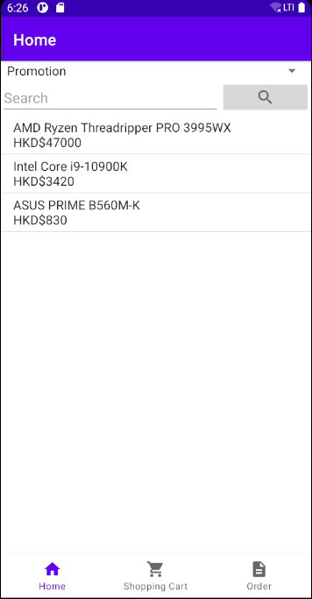
Home Page - Overview

Slide 6
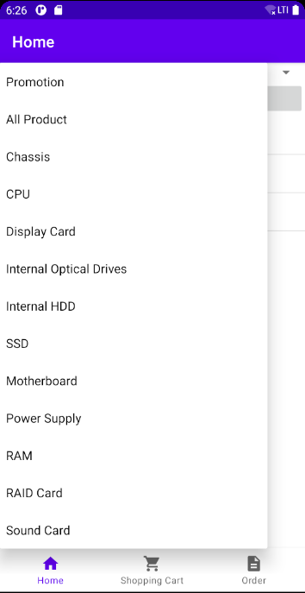
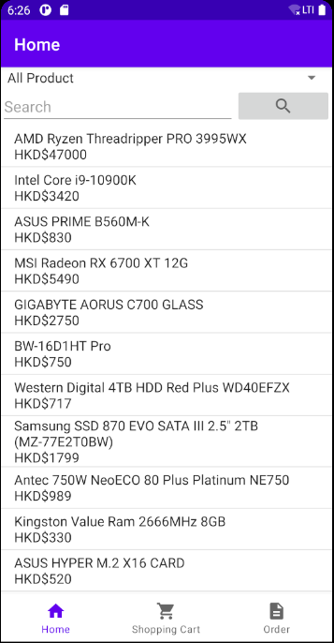
Drop-down List

Slide 7
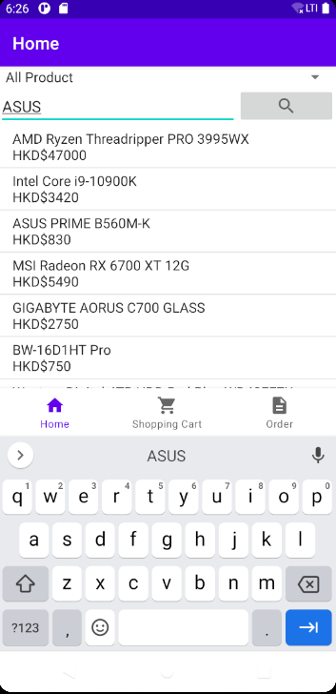
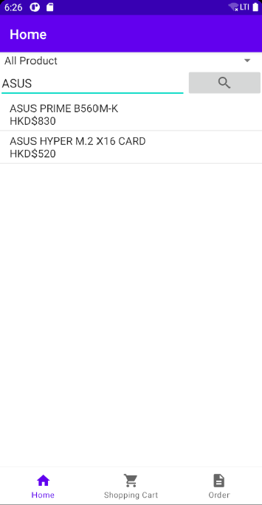
Search Function

Slide 8
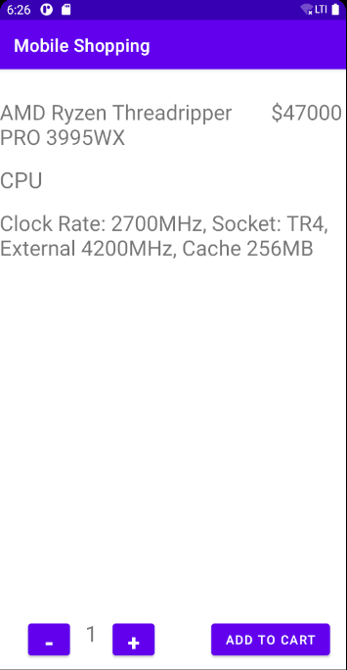
Product Detail
1. Product Name
2. Product Type
3. Description of the product

Slide 9

Shopping Cart Page

Slide 10
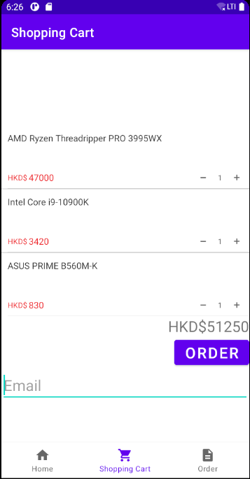
Shopping Cart Page
1. Product Name
2. Unit Price of Product
3. Quantity of Product
4. Total Price of The Order

Slide 11
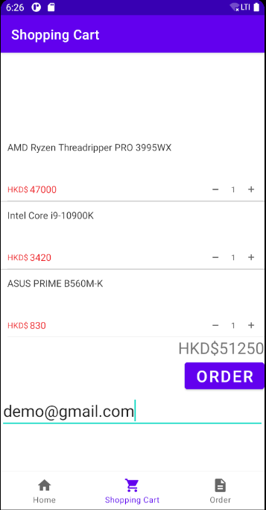
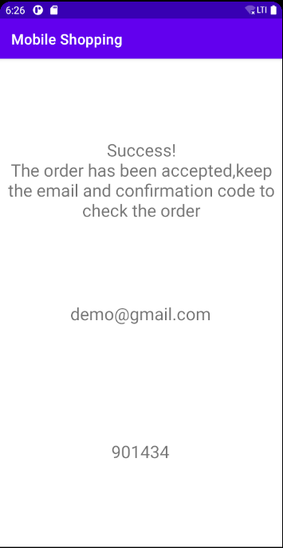
Place Order - 6 digits code

Slide 12
Order Page

Slide 13
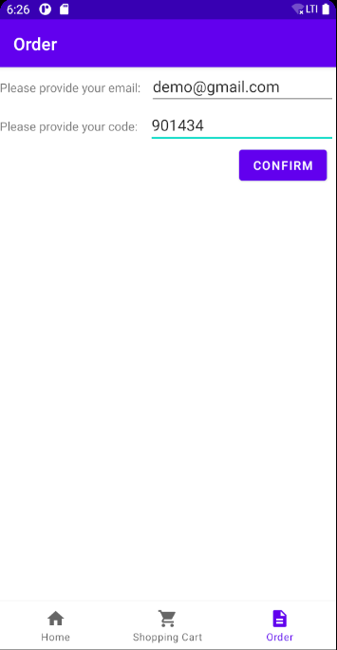
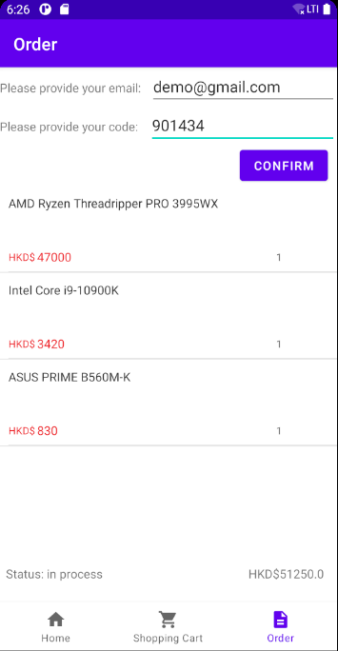
Check order detail
Display order detail
Purchased products
Unit price
Quantity
Total price of the order
The order status

Slide 14

Thank you

